Slide 1
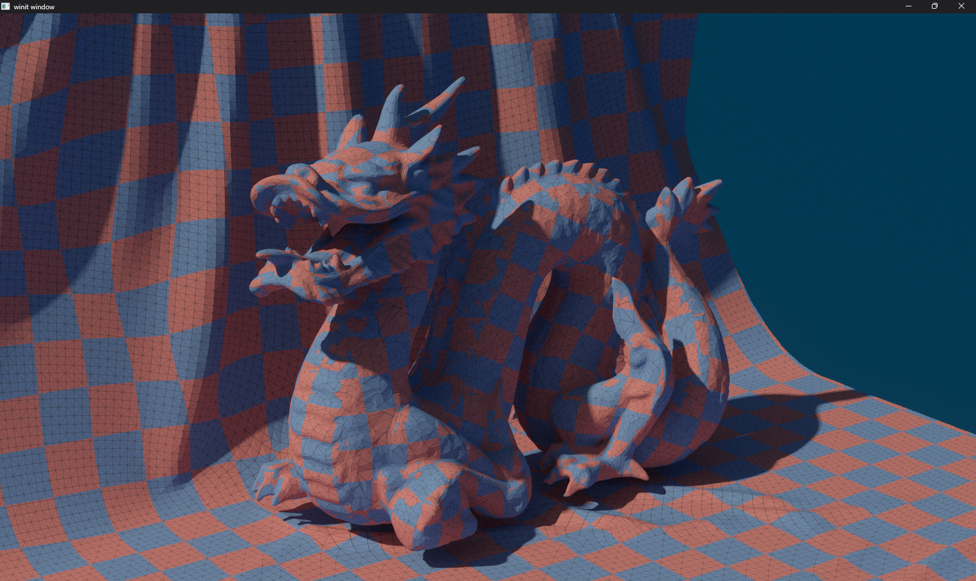
CS 375 Raytracer
By Hartley Blakey

Slide 2
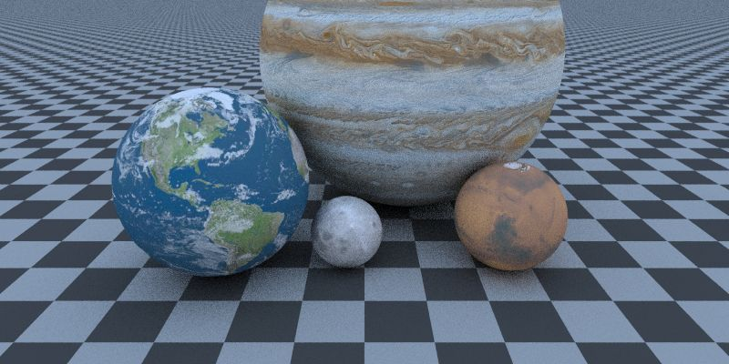
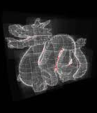
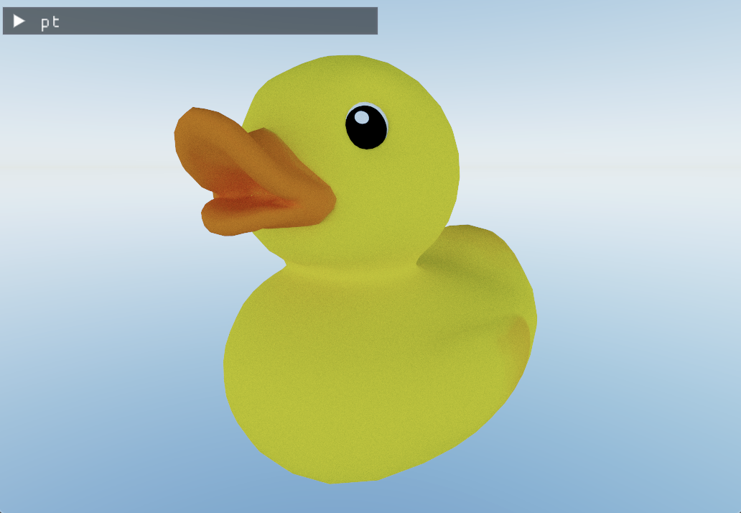
Project Goals
Example Target images
Load triangles from a gltf file
Build a BVH around the triangles to speed up raytracing
Raytrace the bvh in a shader
I wanted to add basic textures

Slide 3
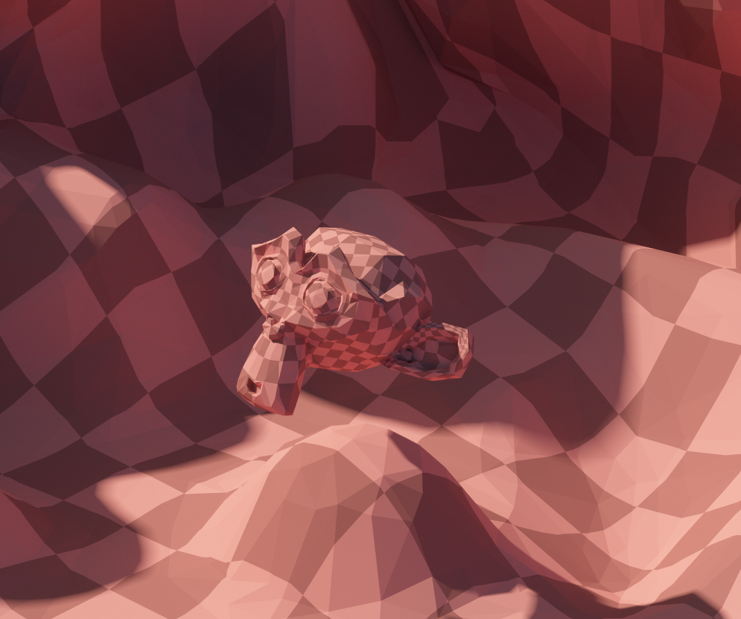
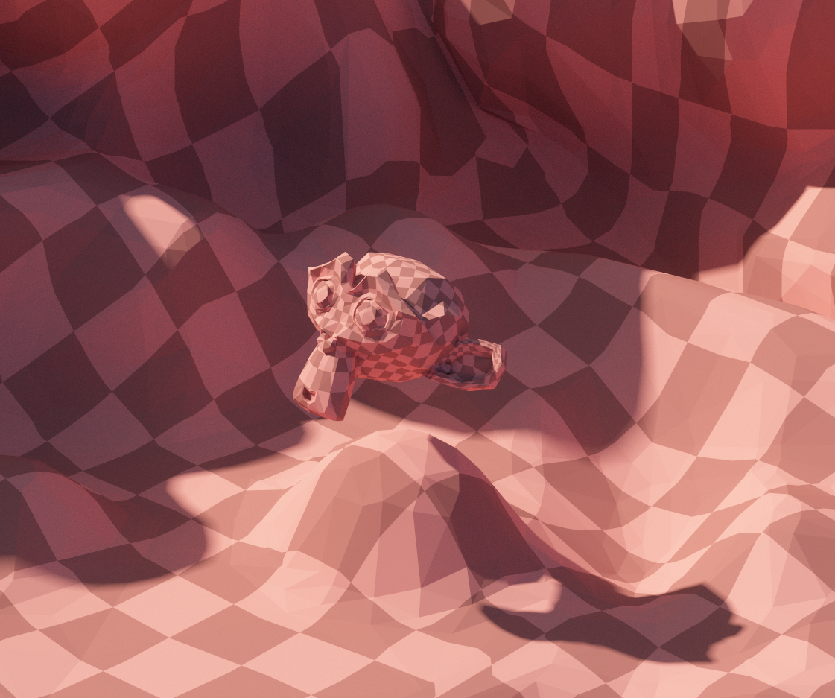
Current state
Triangles loaded from gltf file
Simple bvh, raytraced in a shader
First set of texture coordinates hardcoded into vertex format
No textures

Slide 4
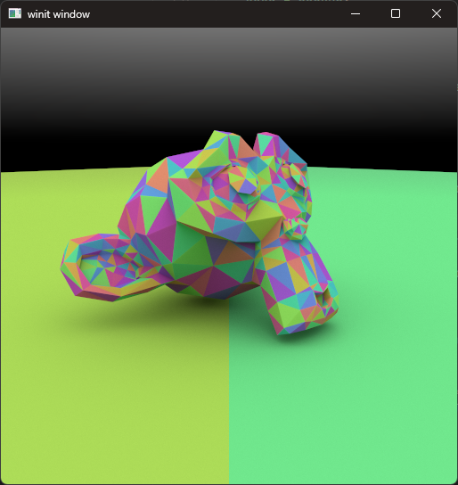
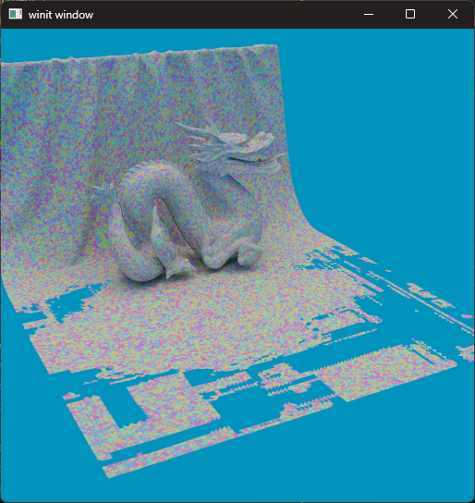
Challenges / Wow moments
Triangles would randomly disappear from certain angles
Thought my BVH was broken
Triangles fixed by making the epsilon smaller in the ray-triangle intersection code I copied
I happened to choose a test scene that broke the midpoint split bvh I was using
I never tested large models, but ray tracing 2 100k triangle dragons was still cool

